Slide 1


HR Analytics
Final Project 2021 – 2023
Submitted by: Group 3 (Section B)

Slide 2
OBJECTIVE
To apply different machine learning models and check which can accurately predict which hospital employees are at risk of leaving their job, and to use this information to implement targeted interventions to reduce attrition rates and retain valuable staff members.

Slide 3
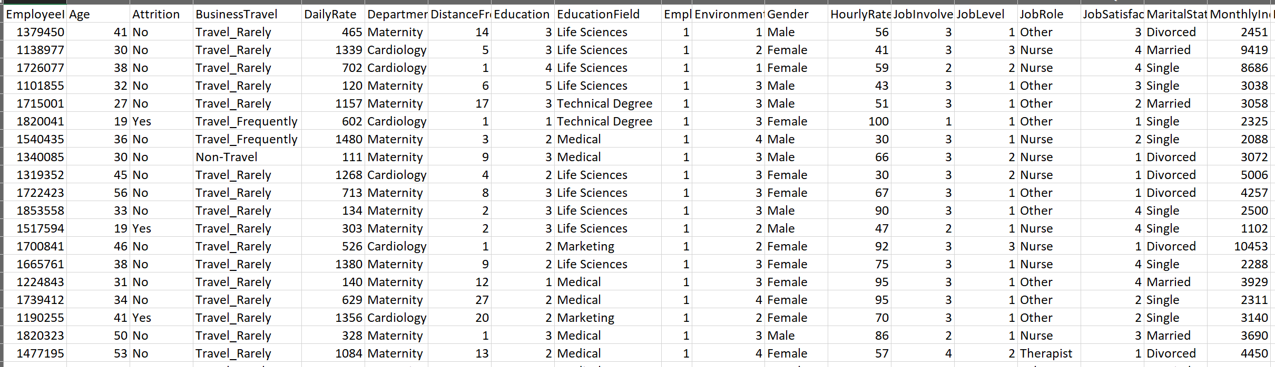
Dataset Description

Slide 4
Dataset Columns
Employee ID
Age
Attrition
Business Travel
Daily Rate
Department
Distance From Home
Education
Education Field
Employee Count
Environment Satisfaction
Percent Salary Hike
Performance Rating
Relationship Status
Training Time Last Year
Gender
Hourly Rate
Job Involvement
Job Level
Job Role
Job Satisfaction
Marital Status
Monthly Income
Monthly Rate
Num Companies worked
Over 18
Over Time
Standard Hours
Shift
Total Working Hours

Slide 5
Hypothesis I
We aim to determine if there is a significant difference in the attrition rate across different departments.
We want to test if working overtime has a significant impact on employee attrition.
Our goal is to investigate if the distance an employee has to travel to work is a significant factor in their likelihood of experiencing attrition.

Slide 6
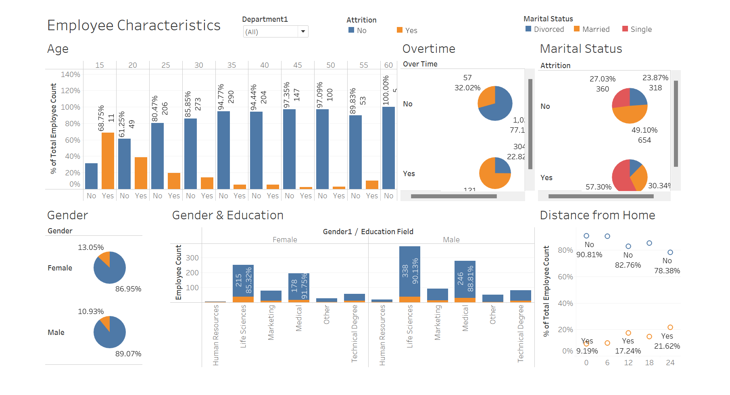
Dashboard 1

Slide 7
Hypothesis II
We seek to determine if job involvement is a significant factor in employee attrition.
We want to test if there is a significant difference in attrition rates among various job roles.
Our aim is to investigate whether an employee's travel pattern has an impact on their likelihood of experiencing attrition.
We want to test if any specific education level is significantly associated with employee attrition.

Slide 8
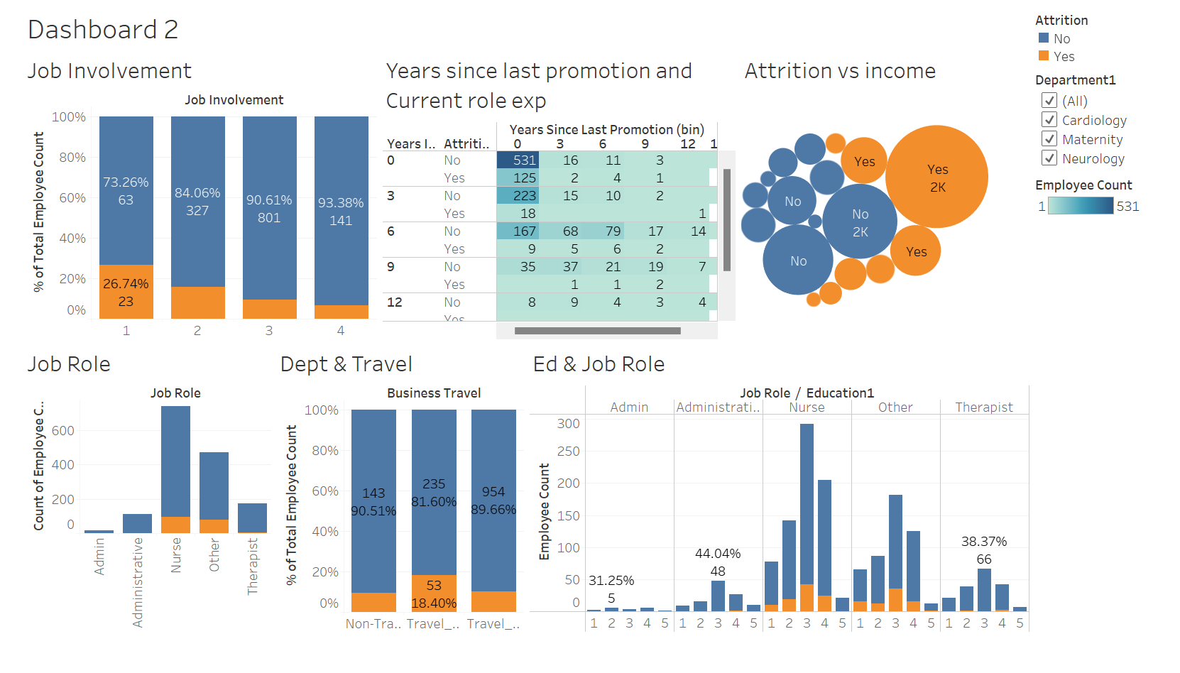
Dashboard 2

Slide 9
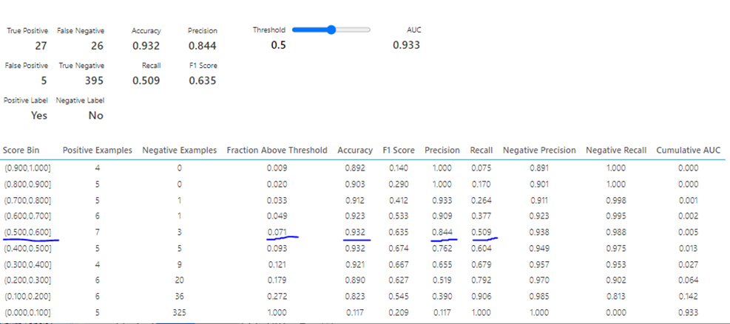
Model 1: Logistic Regression
Without feature and transformation

Slide 10

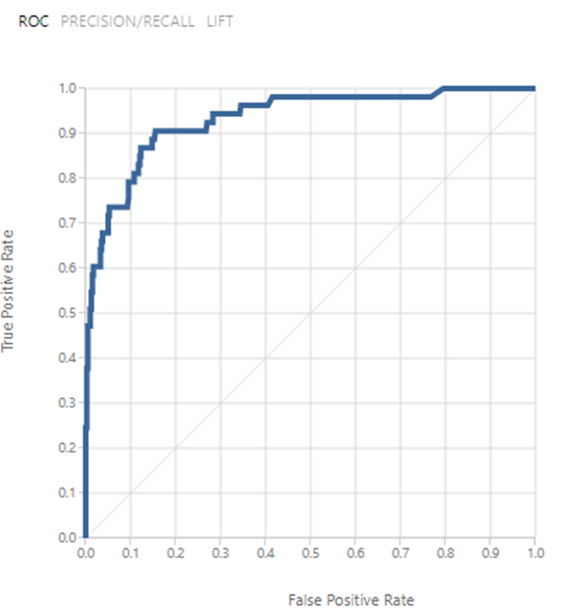
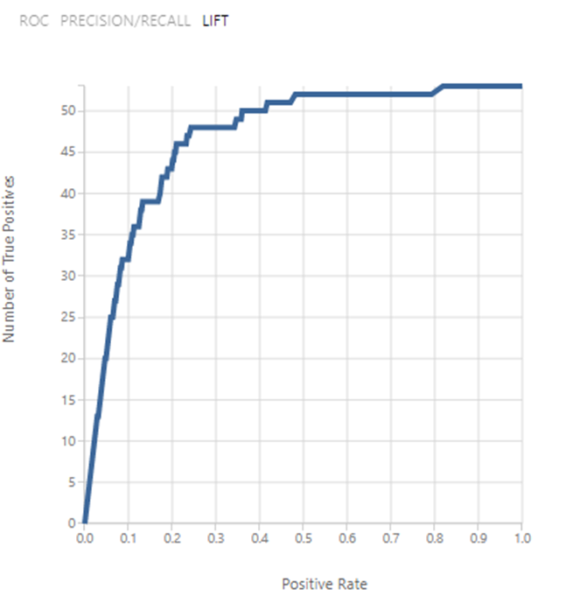
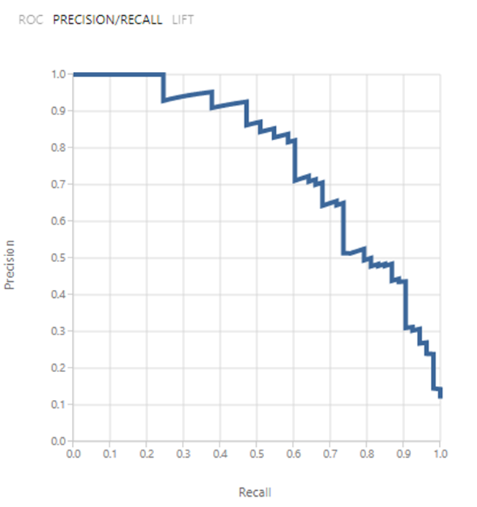

Evaluation

Slide 11

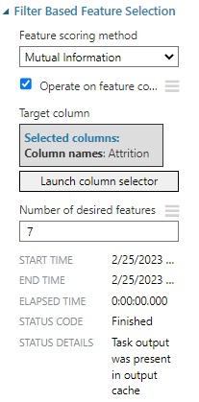
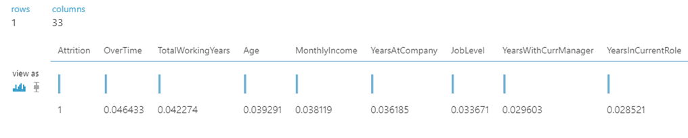
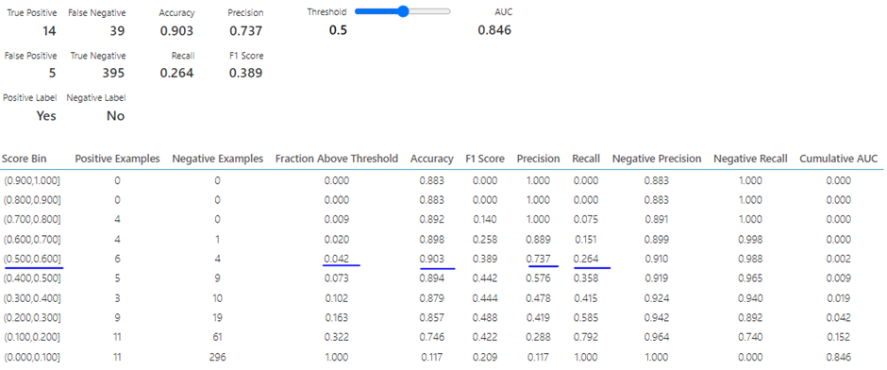
With feature selection only

Slide 12
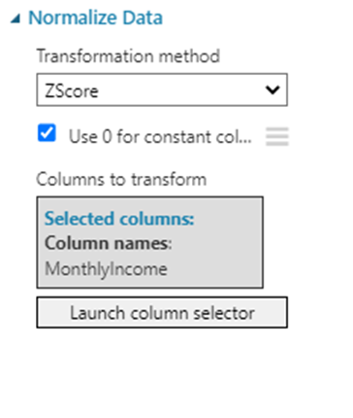
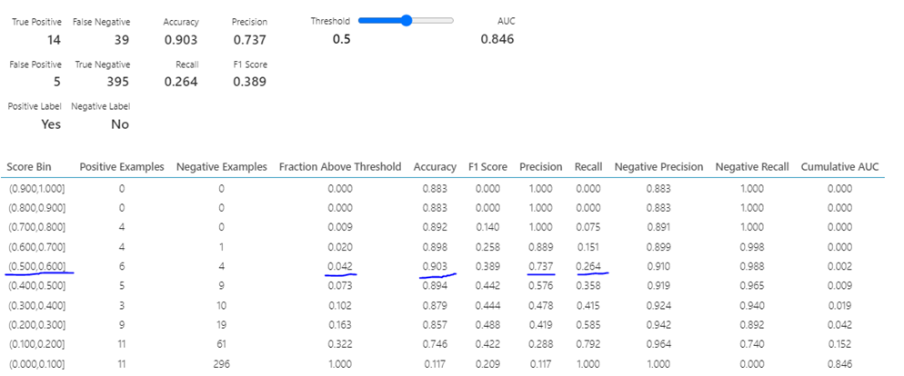
With feature selection and transformation

Slide 13
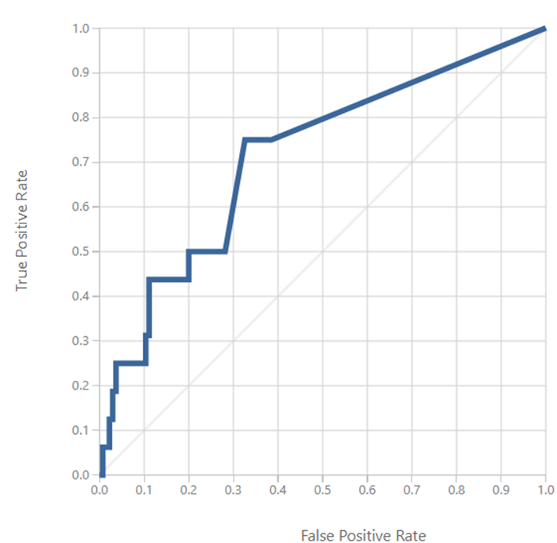
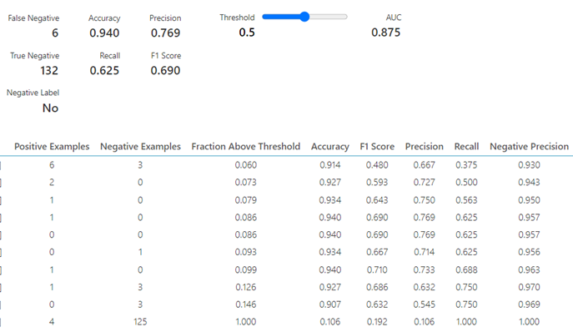
Model 2: Decision Tree
Without feature and transformation

Slide 14
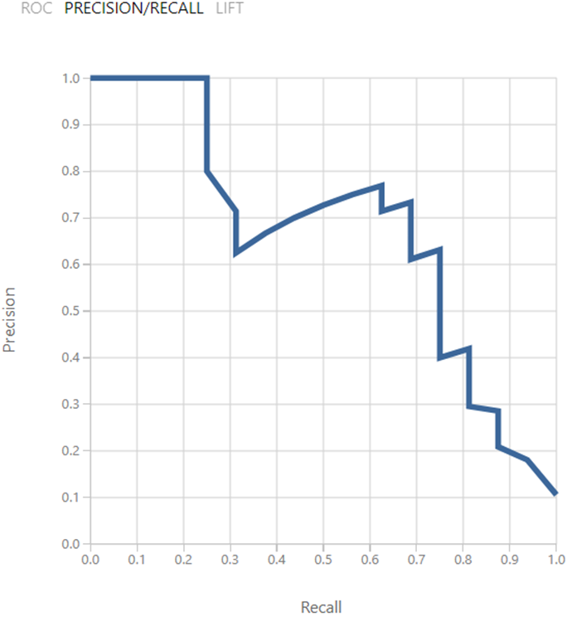
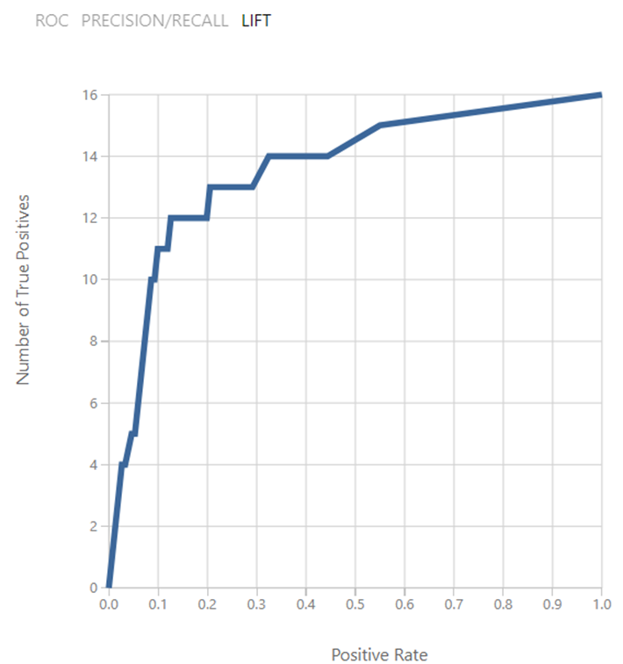
Evaluation

Slide 15
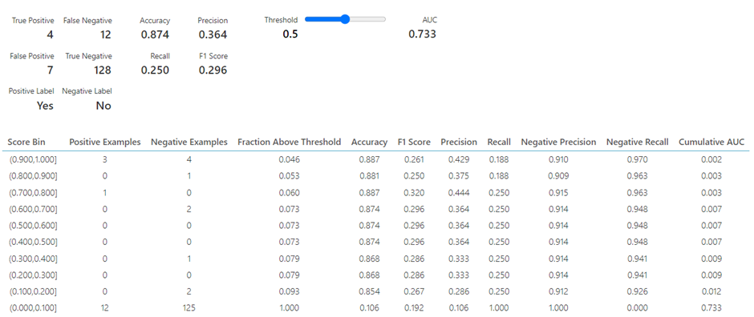
With feature selection only

Slide 16
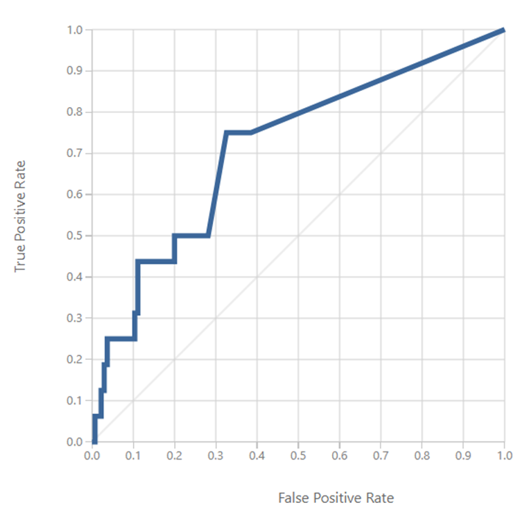
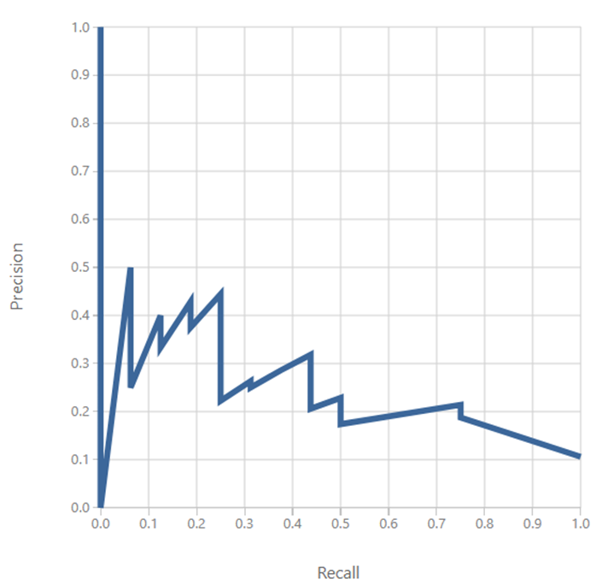
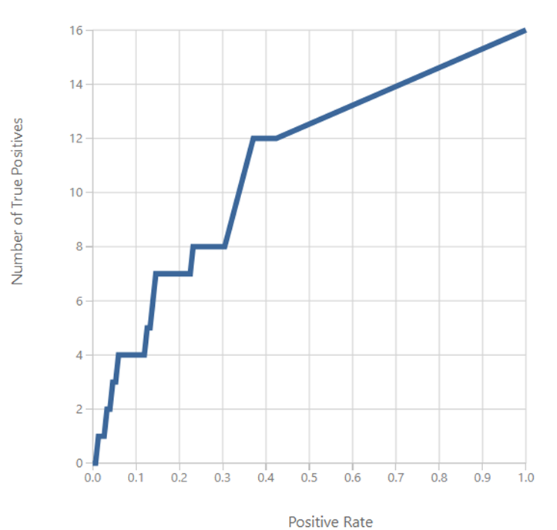
Evaluation

Slide 17
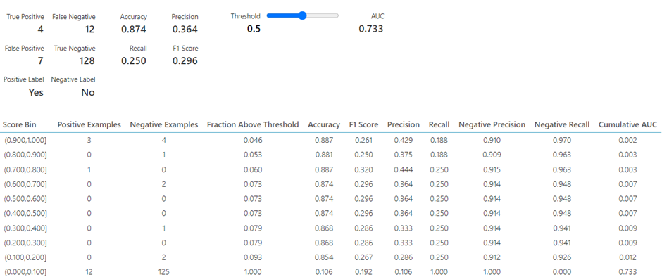
With feature selection and transformation

Slide 18
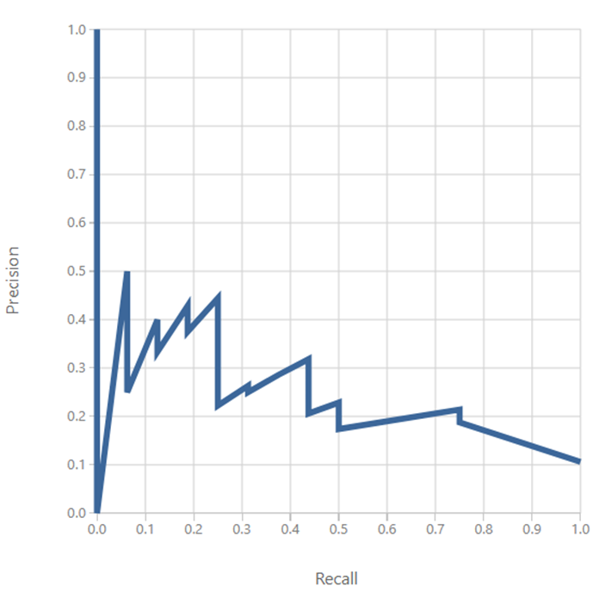
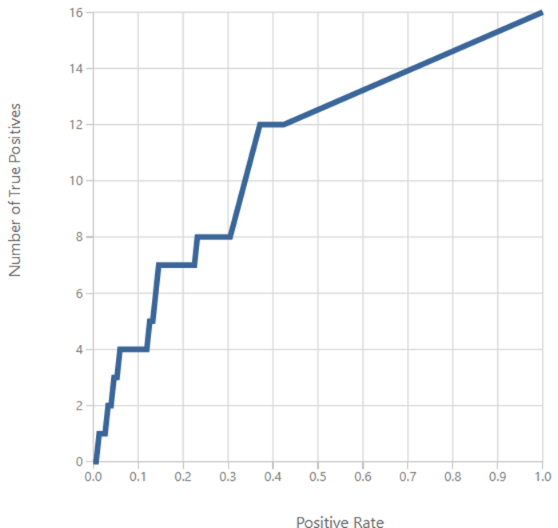
Evaluation

Slide 19
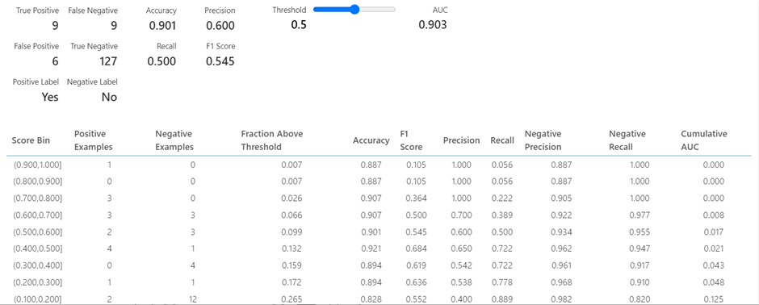
Model 3: SVM
Without feature and transformation

Slide 20
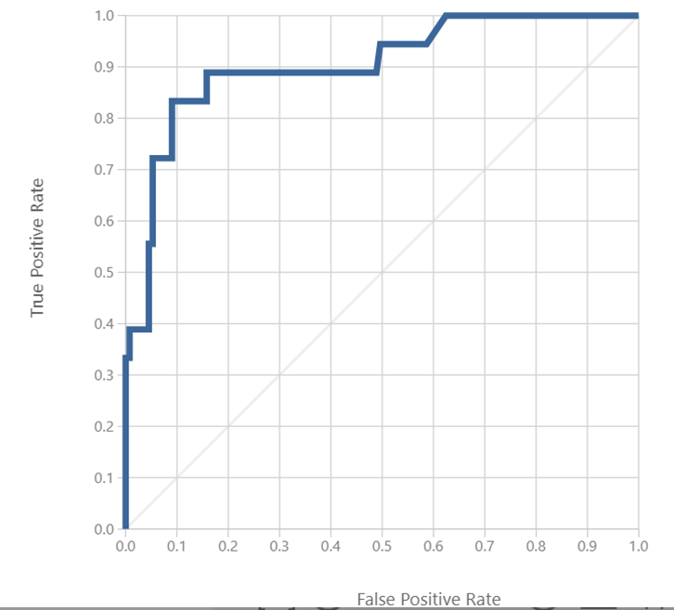
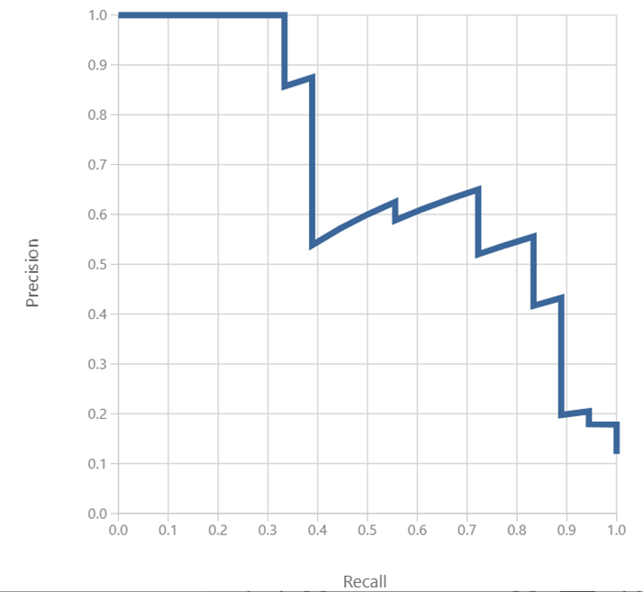
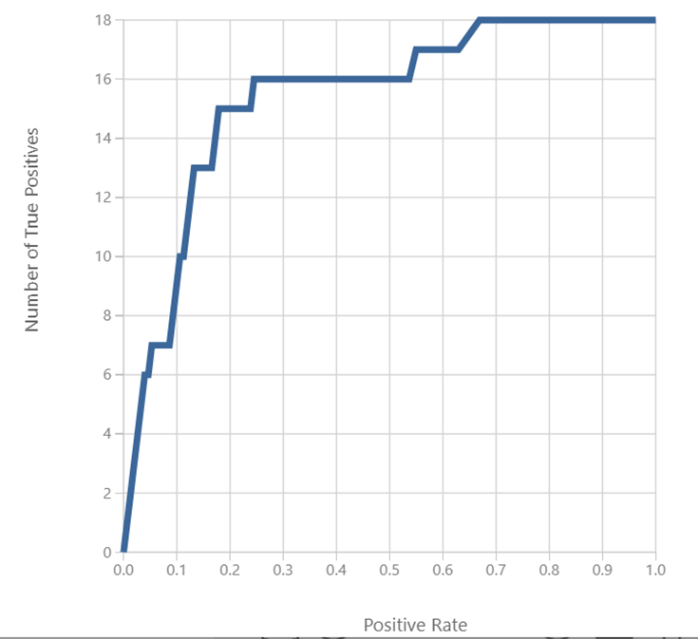
Evaluation

Slide 21
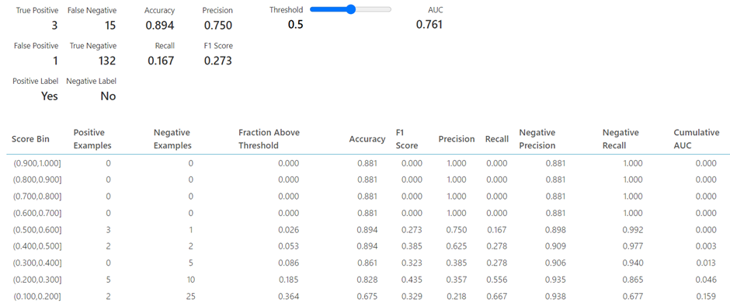
With feature selection only

Slide 22
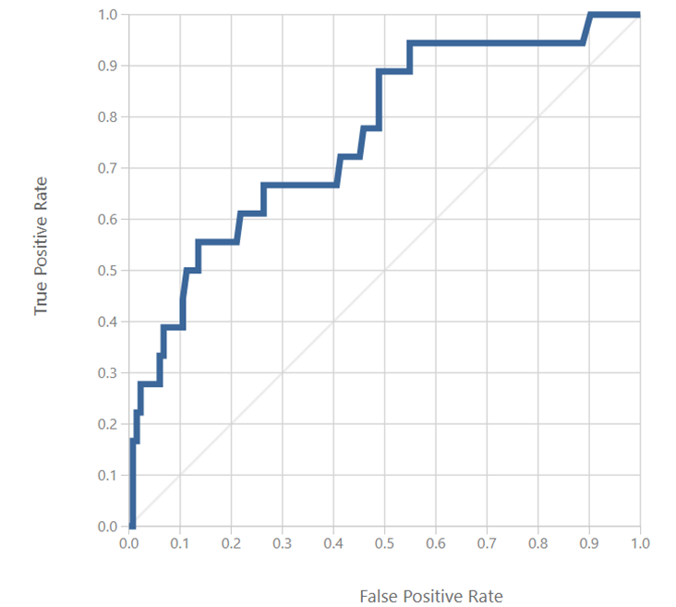
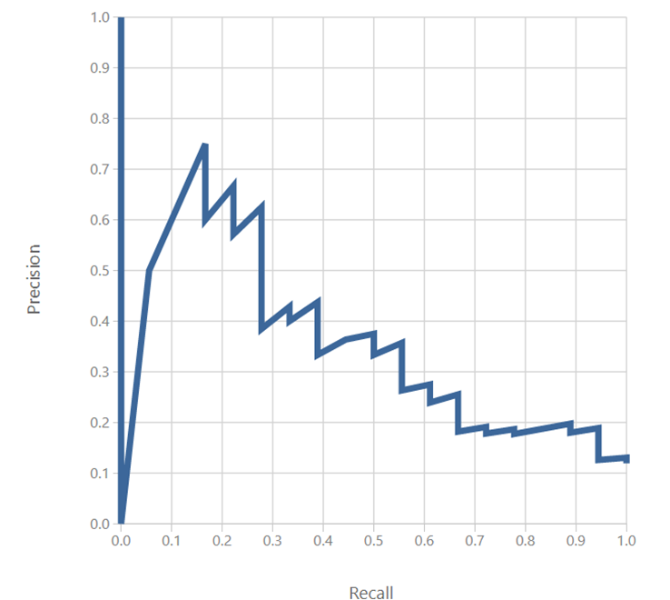
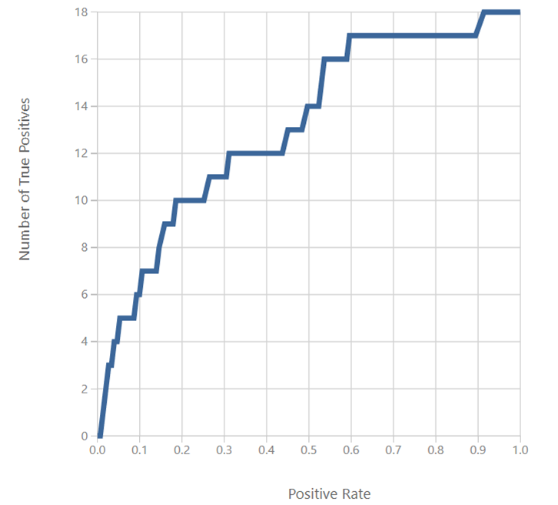
Evaluation

Slide 23

With feature selection and transformation

Slide 24
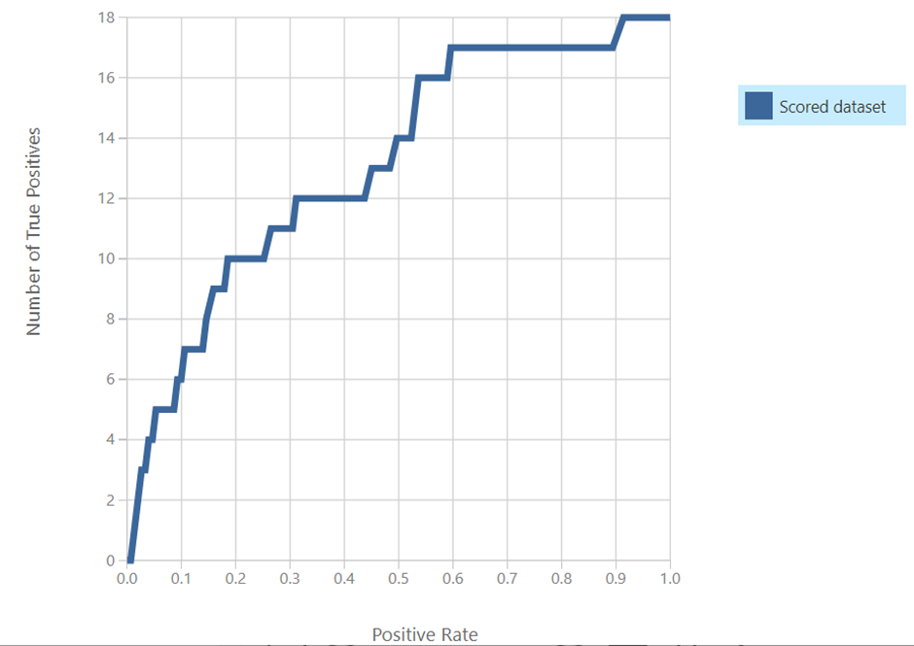
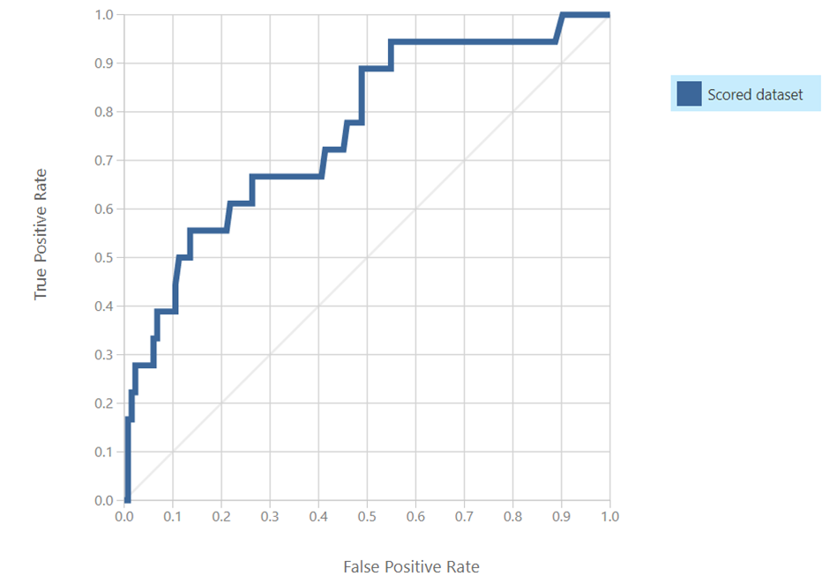
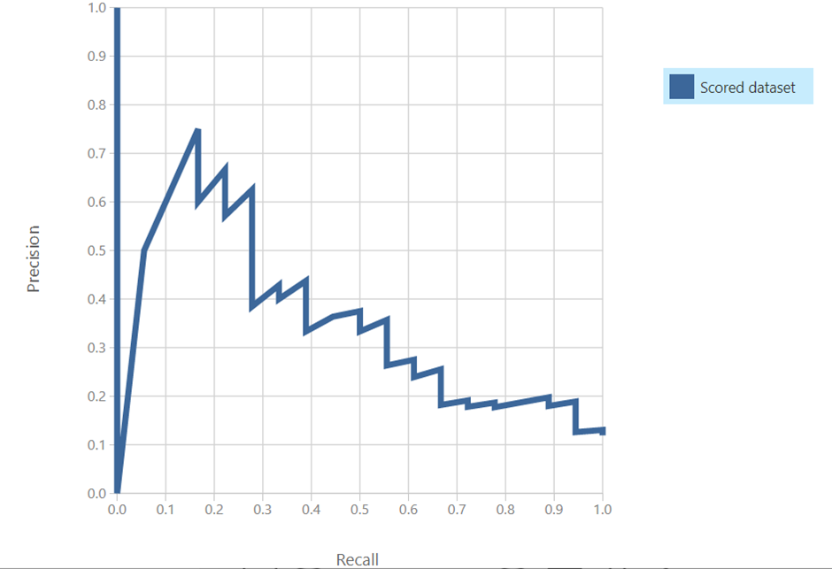
Evaluation

Slide 25
Conclusion
The three models applied show their best results in the first variation where no features are selected, and no transformation methods applied.
After observing the evaluation parameters – accuracy, precision and recall, we can conclude that Logistic Regression is the most accurate and suitable model for this dataset.

Slide 26

THANK YOU

